Slide 1
Database Design Chat 014
How do you tell one thing from another?

Slide 2
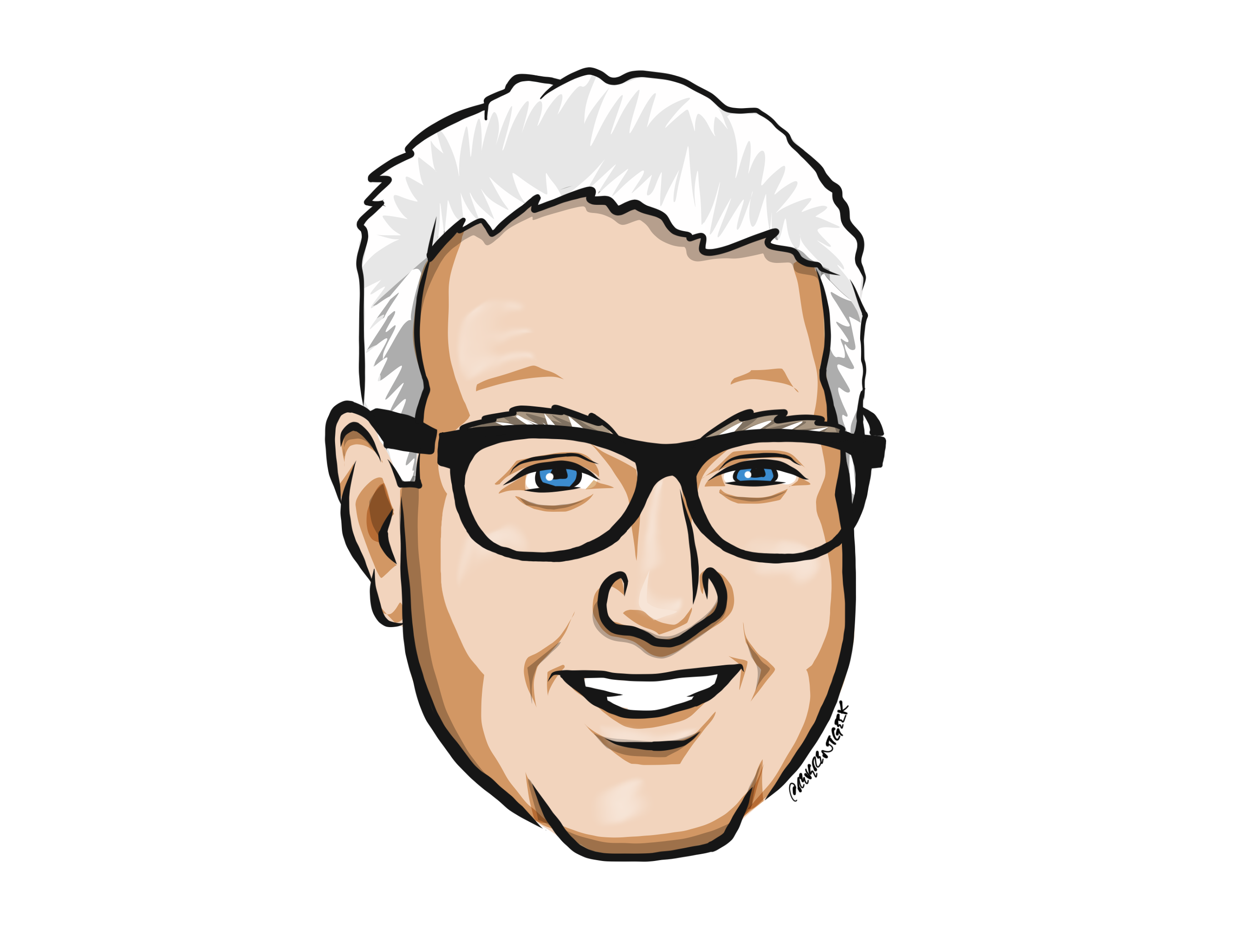
Louis Davidson (drsql)
https://linktr.ee/drsql

Slide 3




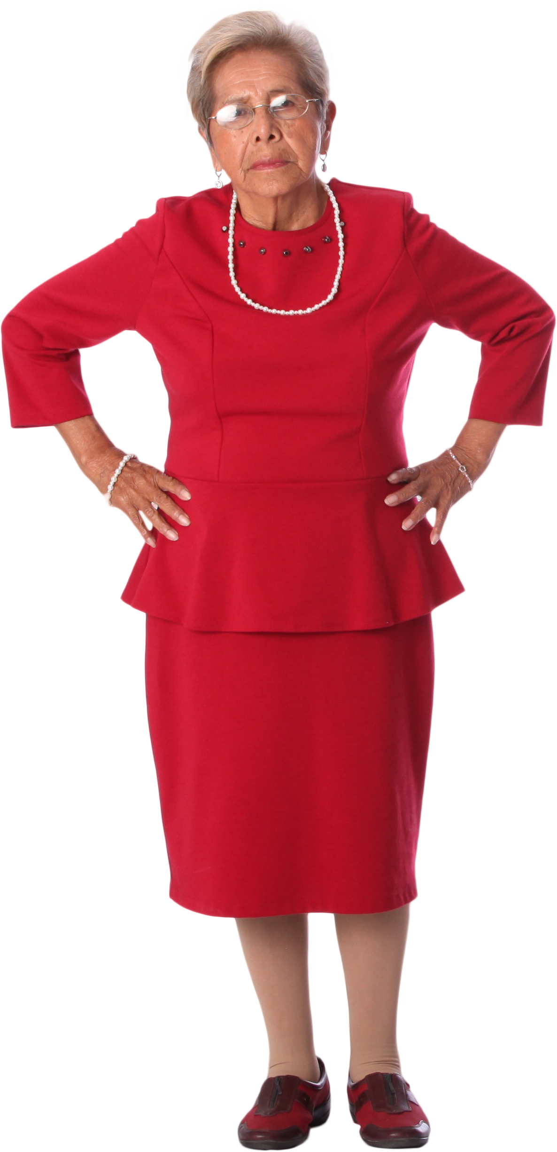
As a practical example
Consider you are a parent of 5 children…

Slide 4




But now they are identical...
And you need to hire a babysitter..

Slide 5
Rows must be unique
The biggest part of this is understanding what the grain you can identify some “thing”
Some things will be counted in bucketfulls (Bulk Uniqueness)
Some things will be specifically and individually identifiable (Normal Case)
Some things can only sometimes be identified (Selective Uniqueness)
Some things don’t actually have a “real” key (Fake Uniqueness)
Some things cannot always be definitively identified (Likely Uniqueness)
We will discuss each of these except the normal case in more detail

Slide 6
Why do we care?
Normalization is all about elimination of duplicate data
How do you know what a duplicate data point is?
By knowing what makes it unique.

Slide 7
The reality is..
You can’t always do what you hope you can
Bottom Line: Design all uniqueness situations (and eventually enforce as much as possible/reasonable).
Consider both Active Integrity Checks (PK, AK) and Passive (Nightly consolidation of data)

Slide 8
Bulk Uniqueness
Dealing with requirements to keep up with “kinds” of things
Example: Grocery store products
Cans of food cannot be treated as individual things, but it is desirable to know exactly how many you have and sold
Produce/Meats may be managed by weight
Our goal here will be to manage:
Types of things
How many items, or buckets of items have been used, wasted, or lost

Slide 9



Example: Bulk Uniqueness
CREATE TABLE Product ( ProductId int NOT NULL PRIMARY KEY, ProductCode char(10) NOT NULL UNIQUE )
CREATE TABLE SalesOrderLineItem (
SalesOrderLineItem int NOT NULL PRIMARY KEY, LineNumber int NOT NULL, ProductId int NOT NULL REFERENCES Product(ProductId), Quantity int NOT NULL, SalesOrderId int NOT NULL REFERENCES SalesOrder(SalesOrderId), UNIQUE (SalesOrderId, LineNumber) )
CREATE TABLE ProductInventoryAdjustment ( ProductInventoryAdjustment int NOT NULL PRIMARY KEY, ProductId int NOT NULL REFERENCES Product(ProductId), AdjustmentType char(10) NOT NULL, AdmustmentAmount int NOT NULL, UNIQUE (ProductId, AdjustmentType) )

Slide 10
Selective Uniqueness
Handling the case where values of a certain type need to be unique
Common cases:
Employee Government ID
Only 1 primary contact per account
1 active address

Slide 11
Example: Selective Uniqueness
CREATE TABLE Employee ( EmployeeId int NOT NULL PRIMARY KEY, EmployeeNumber char(10) NOT NULL UNIQUE, DriversLicenseNumber varchar(100) NULL, DriversLicenseState char(2) NULL CHECK ((DriversLicenseNumber IS NULL AND DriversLicenseState IS NULL) OR (DriversLicenseNumber IS NOT NULL AND DriversLicenseState IS NOT NULL))
);
CREATE UNIQUE INDEX AKDriversLicense ON Employee(DriversLicenseNumber, DriversLicenseState) WHERE DriversLicenseNumber is NOT NULL;

Slide 12
Fake Uniqueness
Thinking back to Relational Form, every row should be unique.
Sometimes this isn’t possible
Capture events from devices may not be 100% unique from each other
Multiple logged multiple actions may have the exact same moment instant
Systems may not provide you unique details
Sometimes may actually be “Partial Uniqueness”
Important to include in your key as much identifying information as you have
Example: 10 devices are sending data, the device identifier should be part of your key
Alternatively, you throw away duplicated readings, though I generally don’t favor such an approach, as it actually complicates programming.
In some cases, you might even leave off the alternate key and just let data stream in, with the surrogate treated as a sequence

Slide 13
Fake Uniqueness
CREATE TABLE Device ( DeviceId int NOT NULL PRIMARY KEY, DeviceNumber char(10) NOT NULL UNIQUE, Etc
);
CREATE TABLE DeviceReading ( DeviceReadingId int NOT NULL IDENTITY PRIMARY KEY, DeviceId INT NOT NULL REFERENCES Device(DeviceId), ReadingTime datetime2(0) NOT NULL, --To the second ReadingSequence int NOT NULL, --* UNIQUE (DeviceId, ReadingSequence) --*
);

Slide 14
Likely Uniqueness
Sometimes you can’t tell two items apart with the same data
People are the best example:
Two people named Louis Davidson show up in a list
Maybe at the same address… with the same phone number…
Are they the same person? two people?
Three people (because someone assumed two of them were actually one?)
While you can’t assume that Louis Davidson and Louis Davidson are the same…
They likely are…

Slide 15
Realism Tip
Avoid getting hung up on structural details too early as you design.
Designs start out nebulous and moves toward an implementation
Just because you can’t think of how to implement something doesn’t mean you don’t model it

Slide 16
Until Next Time
A BIG part of getting correct output from your queries is understanding how to find your data
Knowing what attributes make something unique is a big step in getting your design right
Finding data is the costliest part of working with data in any database
Protecting against duplication and indexing search paths increase concurrent throughput

Slide 17
Questions?
If you have questions, you can:
Comment on YouTube
Email drsql@hotmail.com
Message me on Twitter at drsql
Contact me anywhere on https://linktr.ee/drsql
I may add an episode to discuss or reply directly

